Slide 1
Create the RCM Assessment SAP APM

Slide 2
Presentation content
Step-by-step creation of an RCM | 4
Bibliography | 9
Reference material for doubts and questions | 9

Slide 3
Prerequisites
RCM Assessment: Failure Data Hierarchy
You have the following roles assigned to your user:
RiskCriticalityAssessmentTemplate_Read
RCMAssessments_Read
RCMAssessments_Update
RCMAssessments_Delete
RCMAssessments_Publish
FailureData_Read
TechnicalObject_Read
Function_Create
Function_Update
Function_Delete
FunctionalFailure_Create
FunctionalFailure_Update
FunctionalFailure_Delete
Component | Description | Mandatory / Optional | SAP ERP (Type)
Function | A statement of what the user of an item (equipment, etc.) wants it to do and to what standard of performance. | Mandatory
Maintainable Item | Item that constitutes a part or an assembly of parts that is normally the lowest level in the equipment hierarchy during maintenance. | Optional | Object Parts (B)
Functional Failure | The termination of the ability of an item (equipment, etc.) to perform a required function. | Mandatory
Failure Modes | Describes the way in which the inability of an item (such as equipment) to perform a required function occurs. | Mandatory | Coding (D)
Failure Mechanisms | Describes the physical, chemical, or other processes which have led to the failure (mode). | Optional | Overview of Damage (C)
Causes | Describes the circumstances during design, manufacture or use which have triggered the failure mechanism and led to the failure (mode). | Optional | Causes (5)
Failure Effects | Describes what happens (shows) to the item (equipment, etc.) when a Failure Mode occurs. | Mandatory | Effects (6)

Slide 4
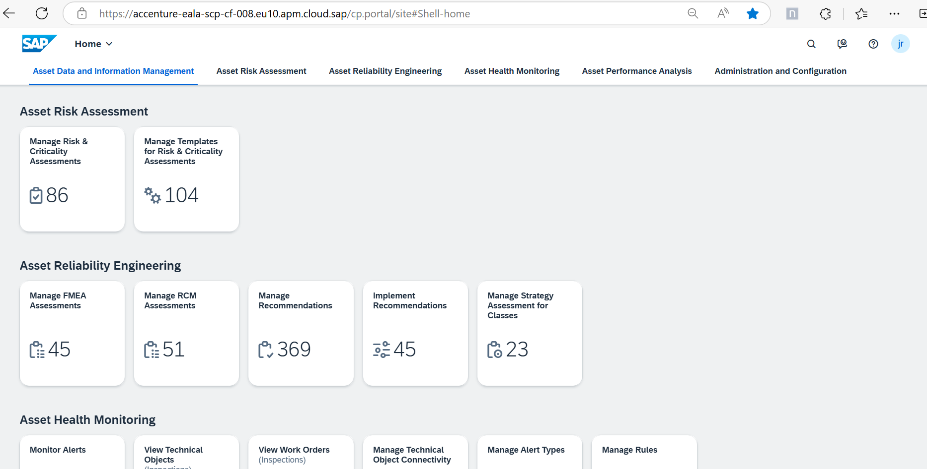
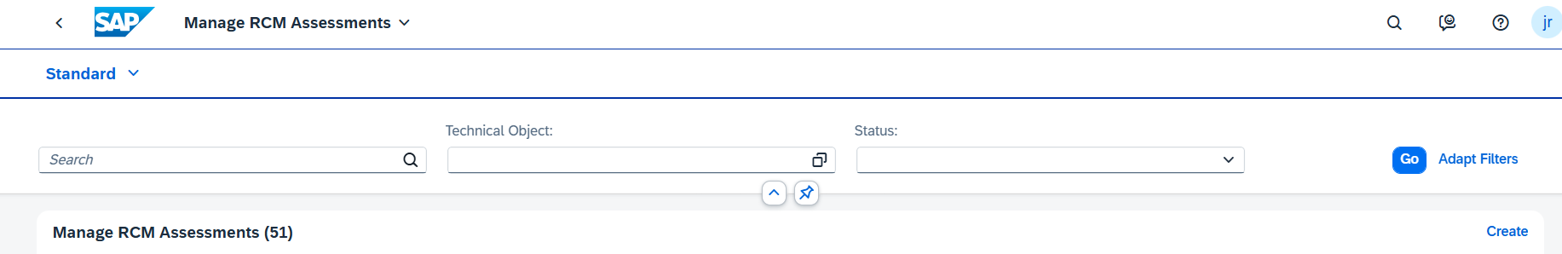
How to Create the Assessment? Step by Step
Create the RCM Assessment:
On the main page of APM, choose the RCM Assessments tile in the Assessment Management tab1
On the RCM Assessments page, click the Create button to start a new assessment
Fill in the Assessment and Description fields. The Long Text field is optional
Select the Technical Object you want to assess. Ensure it has a Failure Data Profile attached1
Save the assessment
1
2

Slide 5
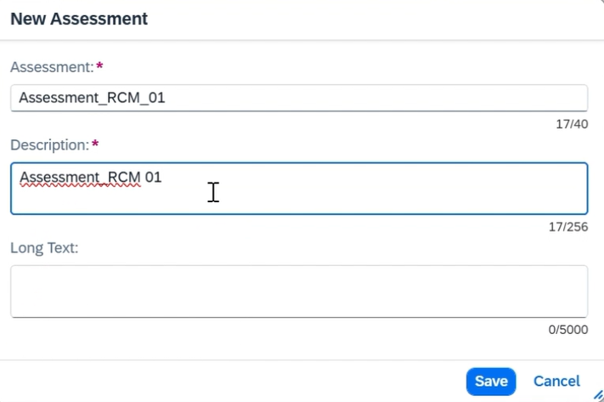
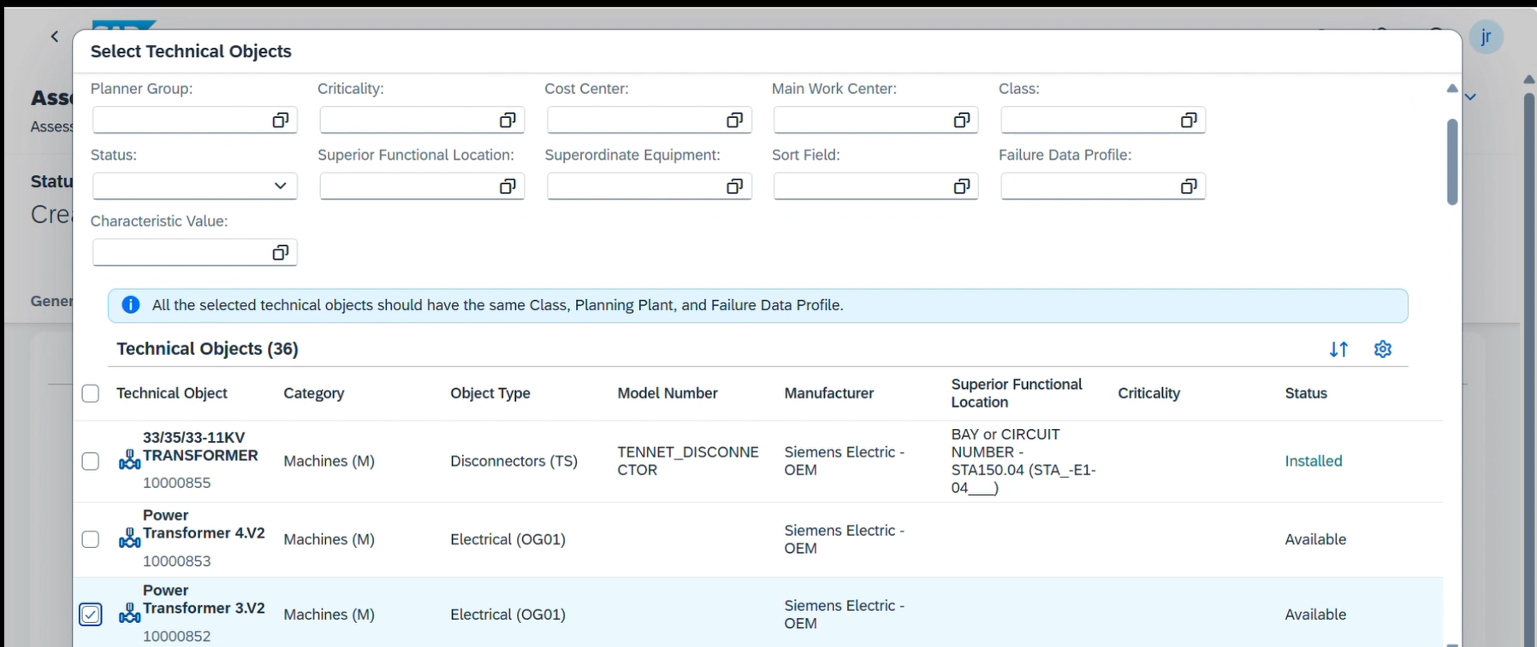

How to Create the Assessment? Step by Step
3
4
Note
You can create new Functions (Code groups and Codes) and then assign them.
You can create new Functional Failures (Code groups and Codes) and then assign them.

Slide 6
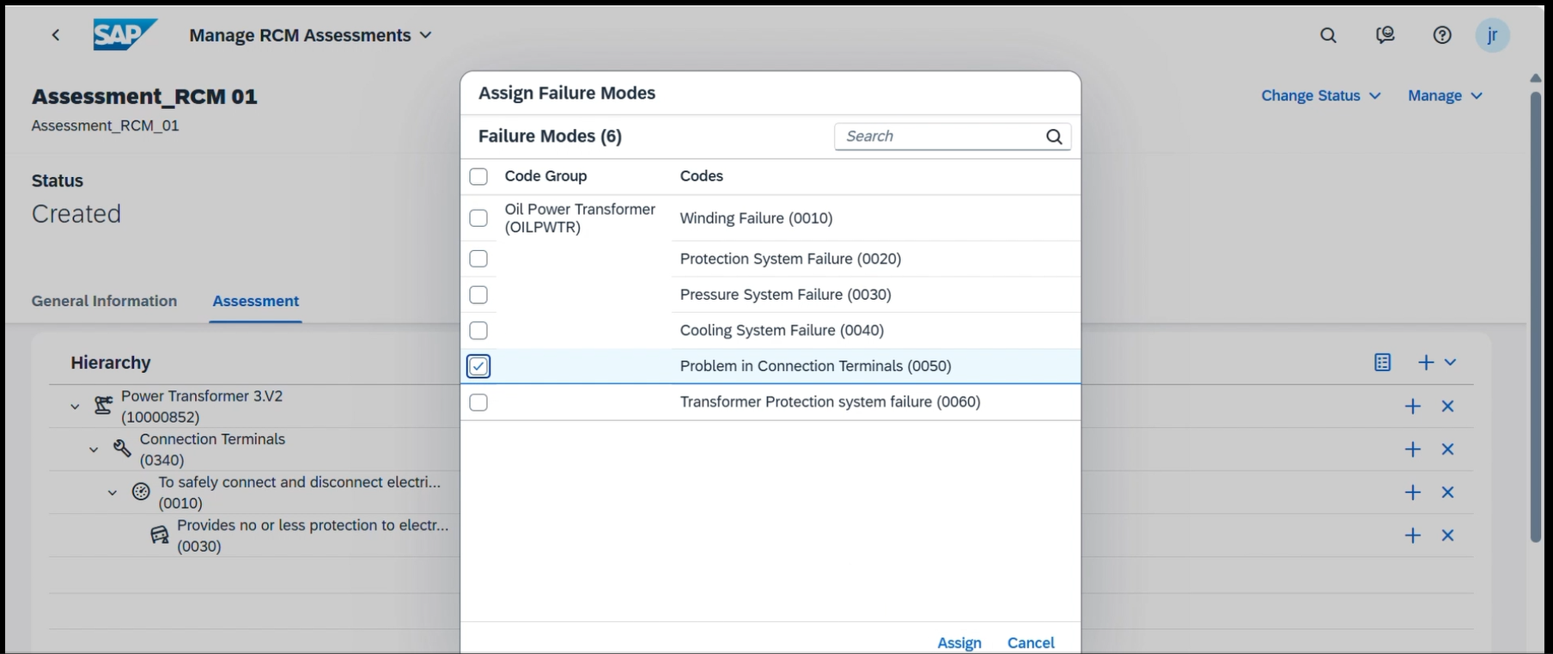
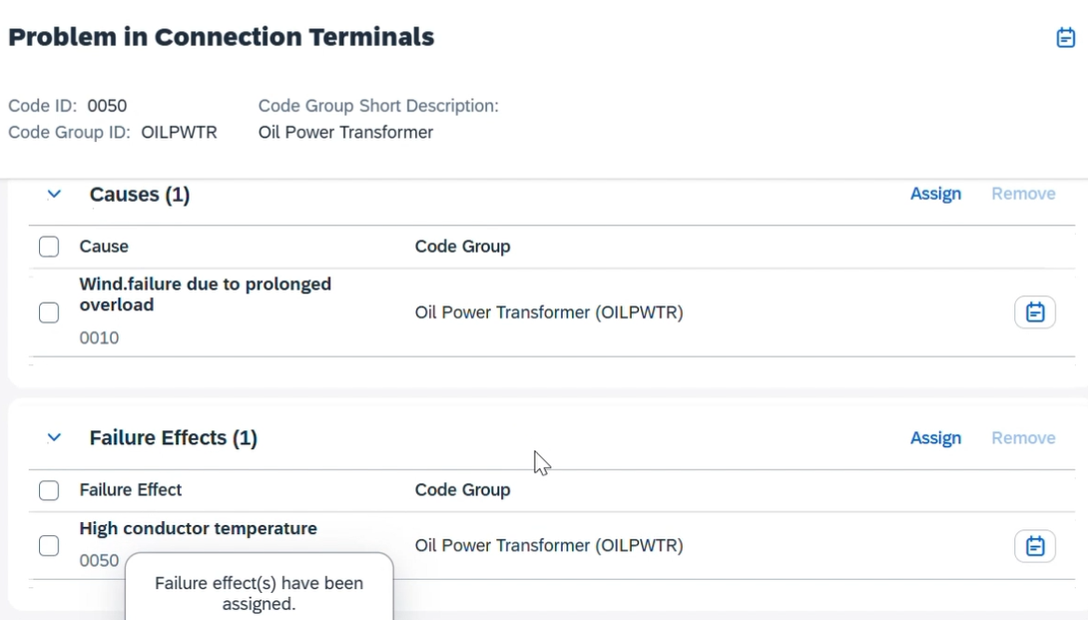
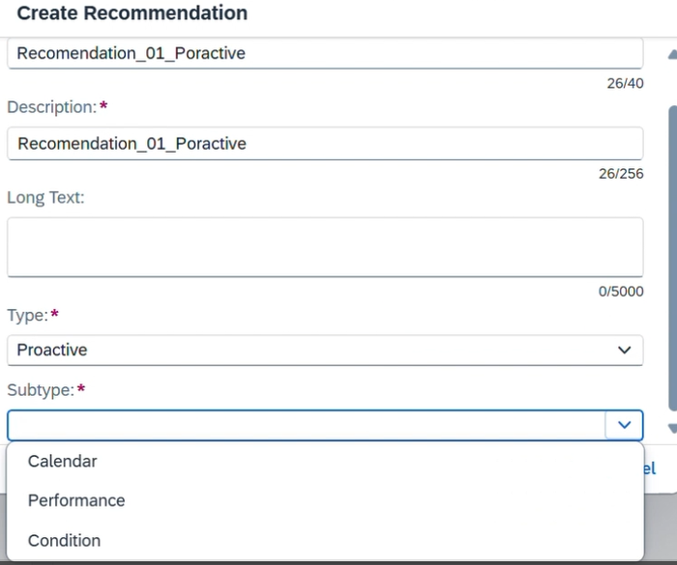
How to Create the Assessment? Step by Step
Assign Failure Data Profile Components and Create a Recommendation:
Assign Functions, Functional Failures, Failure Modes, Failure Mechanisms, Causes, and Failure Effects
Create a new Recommendation and fill in the necessary fields
1
2

Slide 7
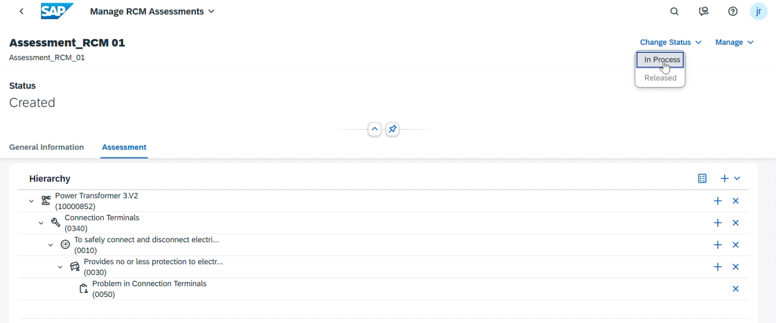
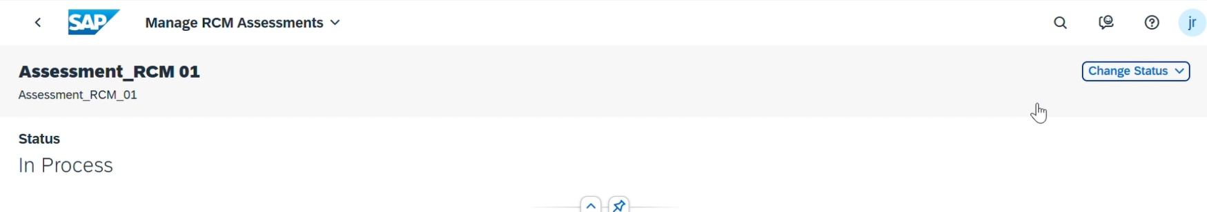
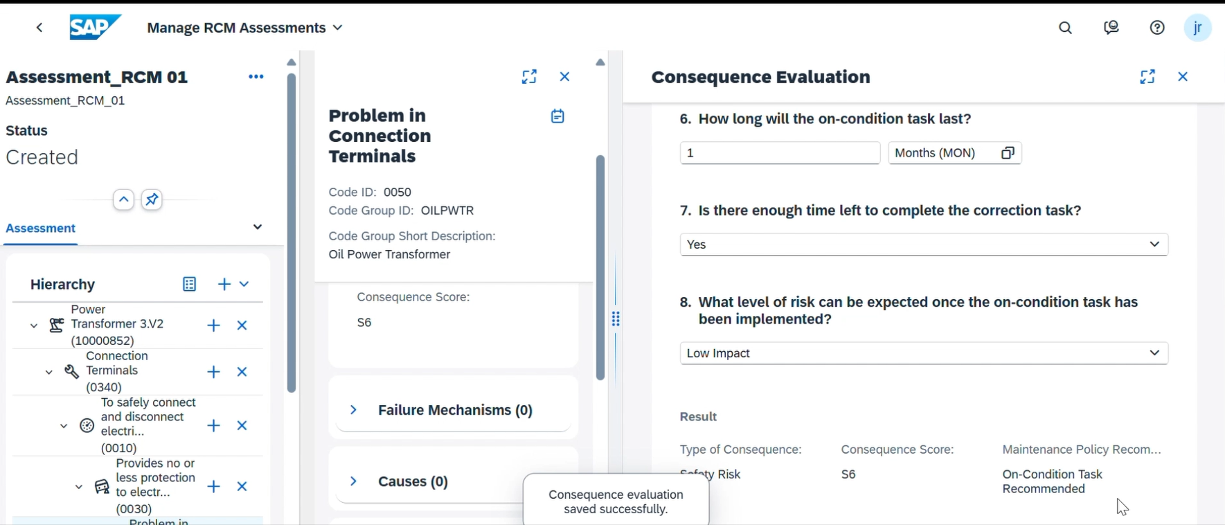
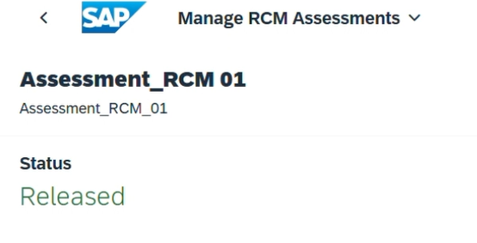
How to Create the Assessment? Step by Step
Change Assessment Status and Perform Consequence Evaluation:
Change the assessment status to "In Process"
Perform the Consequence Evaluation by answering the questions in the decision diagram
Save the evaluation
1
2
3

Slide 8
How to Create the Assessment? Step by Step
Note
All the failure data for the assignment are populated from the failure data profile linked to the technical object
The Catalog Profile along with Catalog Codes are defined in SAP ERP and synchronized to SAP Asset Performance Management. This is to help run assessments and develop maintenance strategies on an aligned failure data model between SAP Asset Performance Management and SAP ERP Asset Management.
The Failure Data codes are replicated from SAP ERP.
Function and Functional Failure are created and maintained in the SAP Asset Performance Management.​

Slide 9
Bibliography
Reference material for doubts and questions
https://help.sap.com/docs/SAP_APM/1bb12075258a41e1a024d28a6ddfe246/6f85b373b45547739bff815aeedc5ffd.html#context
Creating Reliability Centered Maintenance Assessments
FAQ's.xlsx
Asset Health

